Slide 1
BL8800Pro拆装机维修指导手册
BL8800Pro Disassembling and maintenance user manuals

Slide 2
技 术 文 件
Technical Files
文件名称: BL8800Pro拆装机维修手册
BL8800Pro Disassembling and maintenance user manuals
版本 : V1.1
Version: V1.1
部门：
姓名：
日期：

Slide 3
目录Catalogue
1、整机外观检查
Overall appearance inspection
2、拆机过程需要注意的事项
Precautions when disassembling
3、需要的仪器设备和工具
Instruments and tools as needed
4、拆机步骤
Disassembling steps
5、装机步骤
Installation steps
6、软件升级操作
Software updating operations
7、分模块常见问题维修方法
Maintenance method of common problems by module
8、产品爆炸图
The explosion pictures

Slide 4
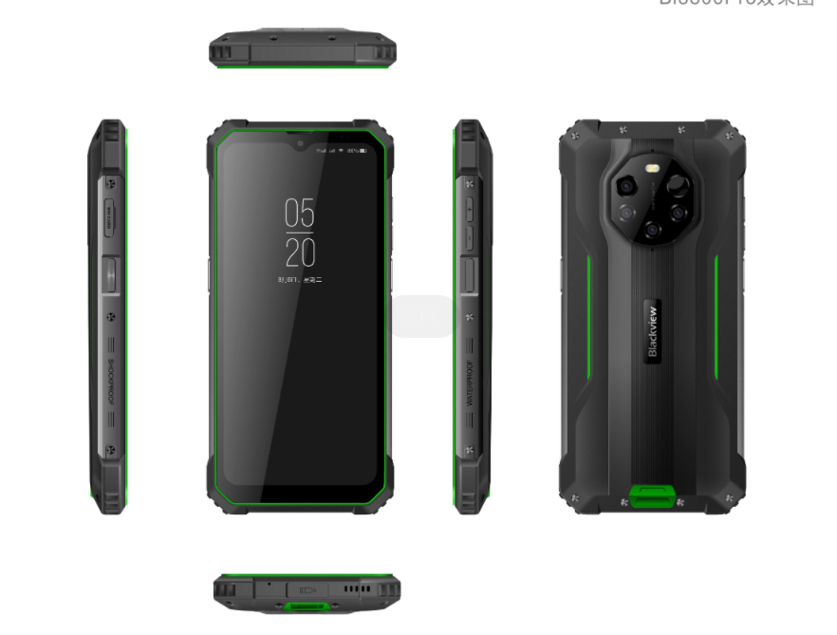
1、整机外观检查
Overall appearance inspection
1、检查机身是否有明显碰撞、跌落损失情况
Check if the phone has obvious collision or fall down
2、检查屏幕是否有刮痕、破裂情况
Check if the screen with scratches and cracks
3、检查USB、耳机接口塞或耳机盖和SIM卡托是否完整
Check USB, headphone jack or cover and sim card tray if is complete
BL8800Pro 正面
Positive
BL8800Pro 背面
Reversed

Slide 5
2、拆机过程需要注意的事项
Precautions when disassembling
1、拆机前操作台面、人体做好静电防护措施。
The electrostatic protection measures should be taken on the operating table and human body before dismantling the phone.
2、操作台面干净整洁，尖锐金属工具整齐放好。
The operating table should be clean and tidy, sharp metal tools neatly placed.
3、准备好需要使用的工具：螺丝刀、镊子、撬棒等。
Prepare the tools to use: screwdriver,tweezers, crowbar, etc

Slide 6
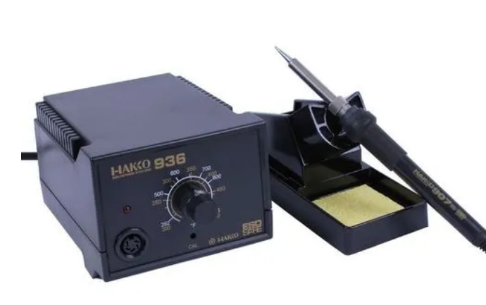

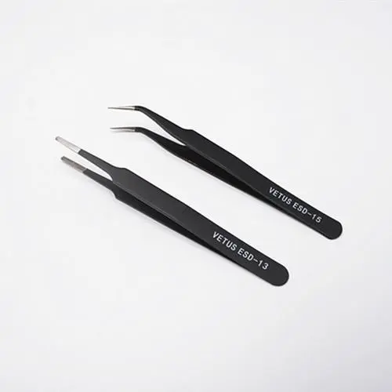
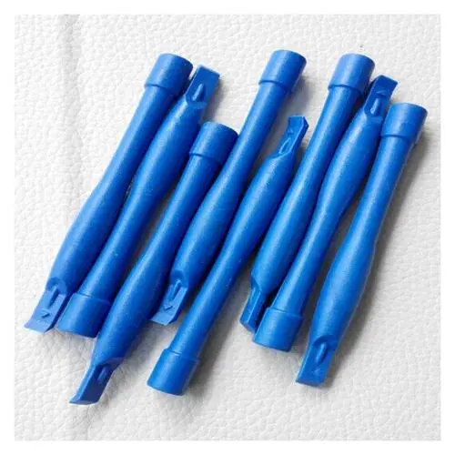
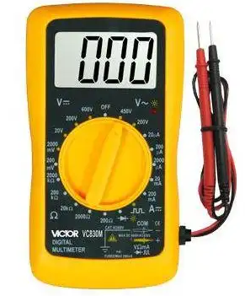
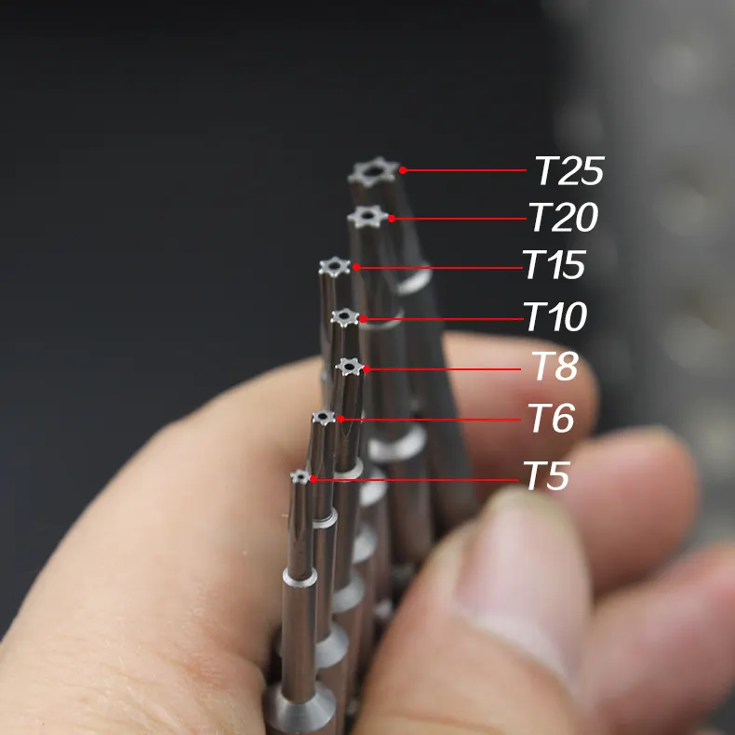
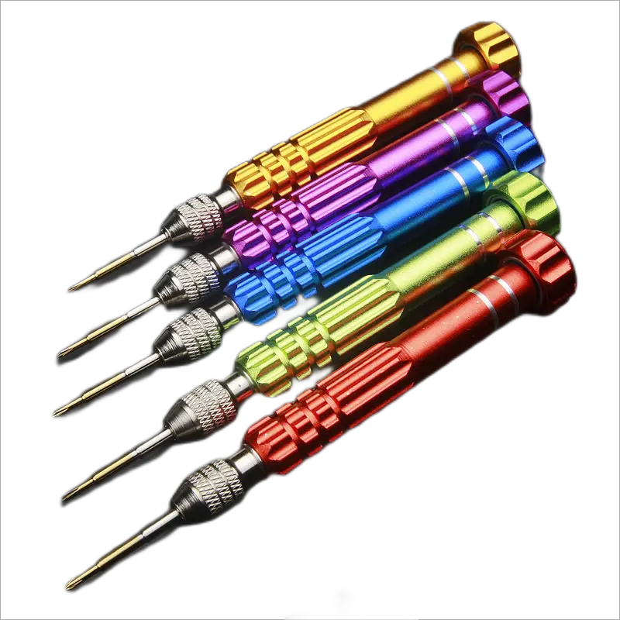

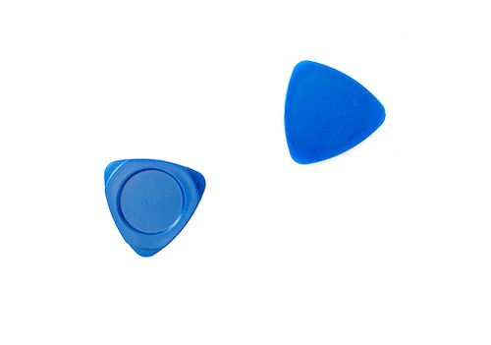
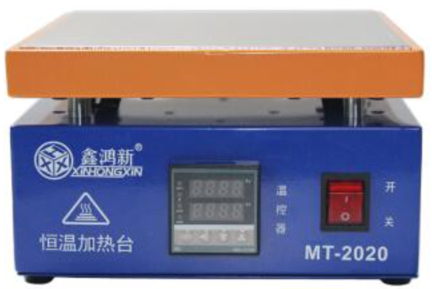
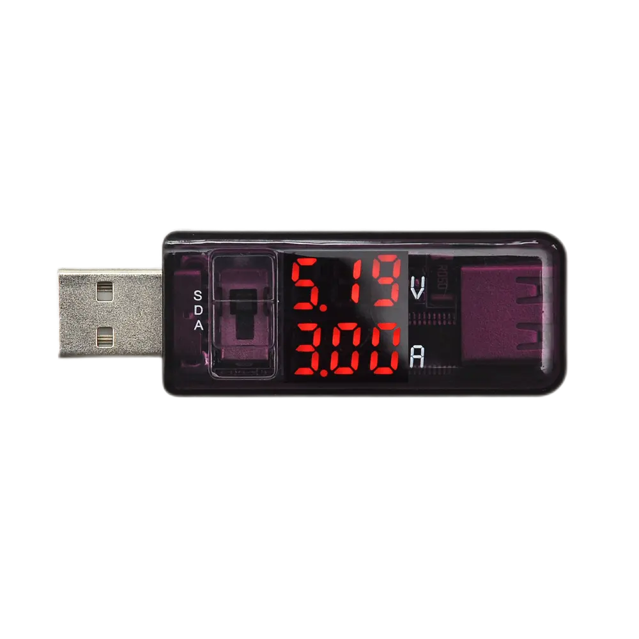
3、常用的仪器设备和工具 3、Common instruments and tools
根据实际机型需求选取工具
电烙铁electric soldering iron 无铅锡线Lead-free tin wire 镊子tweezers 撬棒Crowbar
万用表multimeter
拨片pick
T5内六角螺丝刀 十字螺丝刀 吸盘
USB电流计
加热台

Slide 7
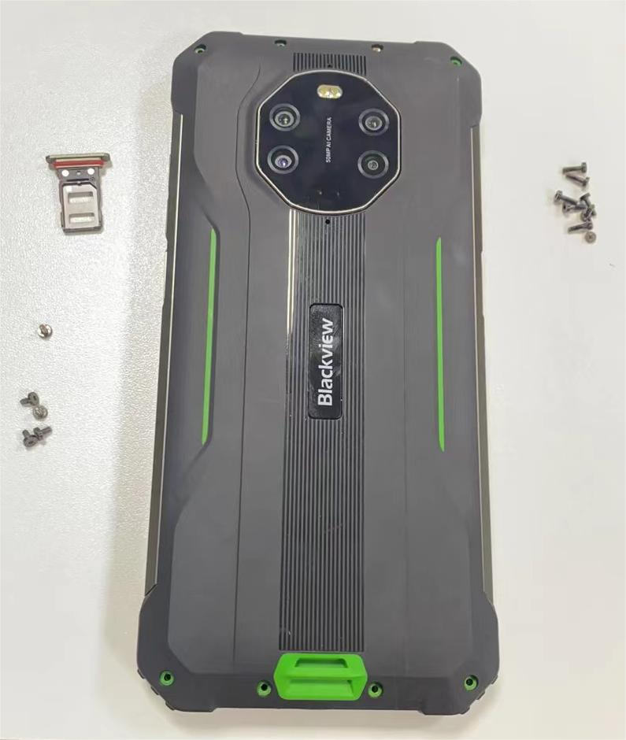
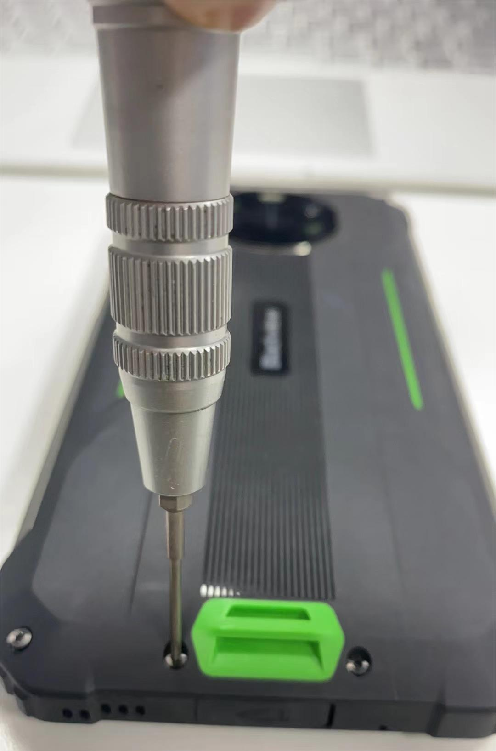
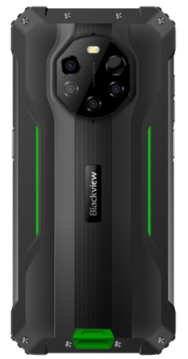
4、拆机步骤
Disassembling steps
4.1、取下SIM卡托，使用T5螺丝刀取下机器背面8颗螺丝和两侧面6颗螺丝，螺丝分类放好。
take down the sim card tray,use T5 screwdriver to remove 8 screws on the back of the phone and 6 screws on both sides, sort the screws and put them in place

Slide 8
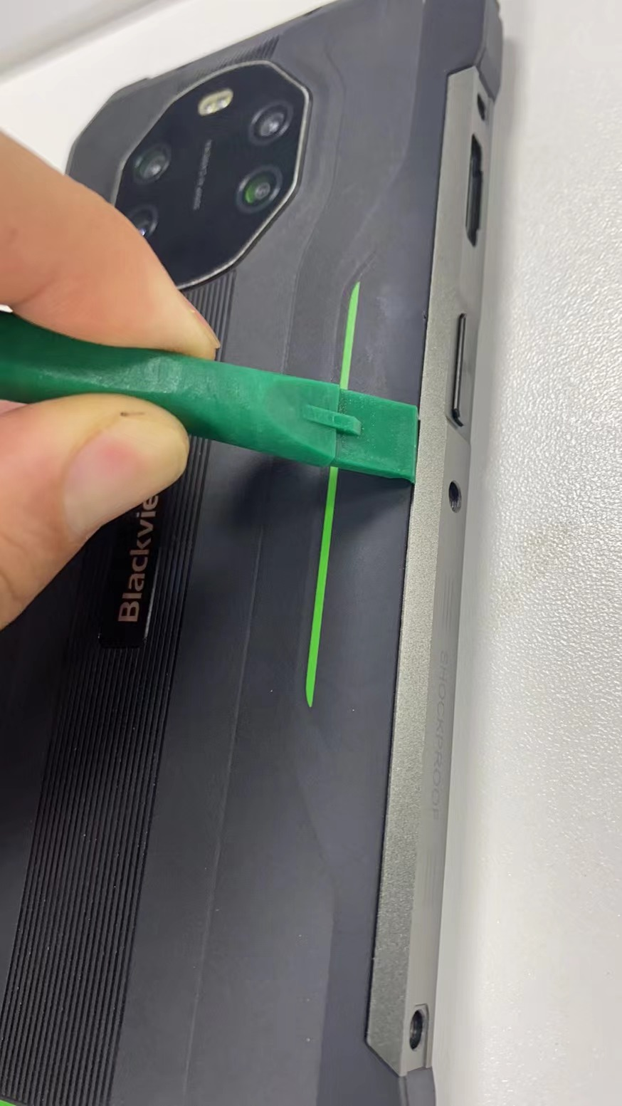
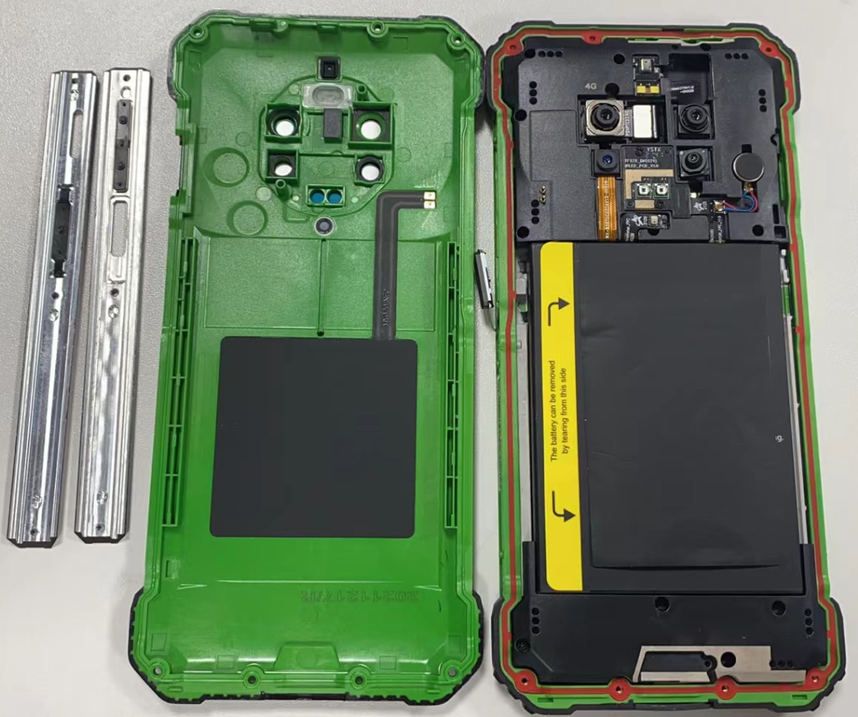
4.2、拆两侧装饰条、后盖
Remove both sides of the decorative strip, back cover
使用撬棒插入装饰条和后盖间缝隙，撬下两侧装饰条。注意收拾好音量键和自定义键，然后打开后盖。
Use the crowbar insert the gap between the trim strip and the back cover, pry down the trim strip on both sides. Take care to pack the volume keys and custom keys, and then open the back cover.

Slide 9
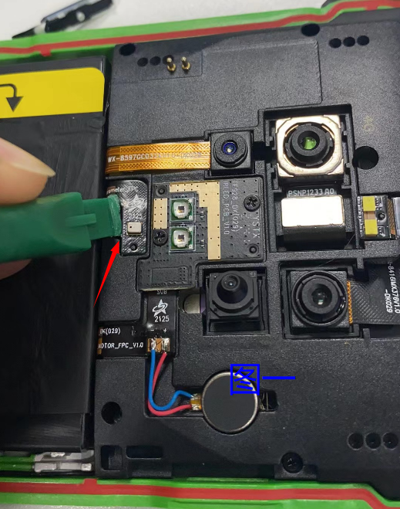
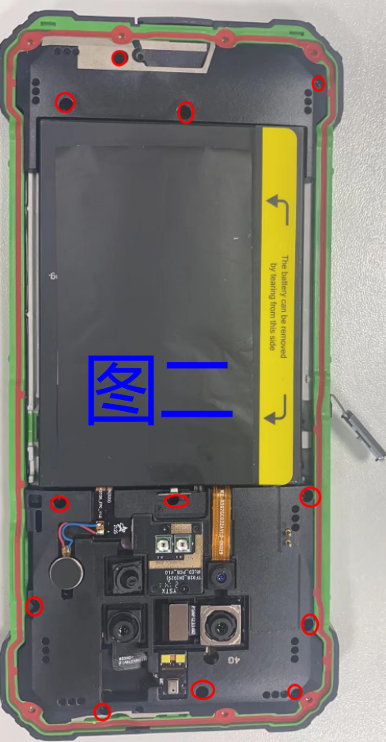
4.2、拆主板支架和喇叭螺丝
Remove motherboard stand and speaker screws
4.2.1、用撬棒轻轻撬开气压FPC，如图一
Use the crowbar to pry up air pressure FPC, as below picture 1
4.2.2、用十字螺丝刀依次取出红圈内的螺丝并收拾好。如图二
Remove the screws as below picture red circle marked by screwdriver and pack them up, as below picture 2
2
1

Slide 10
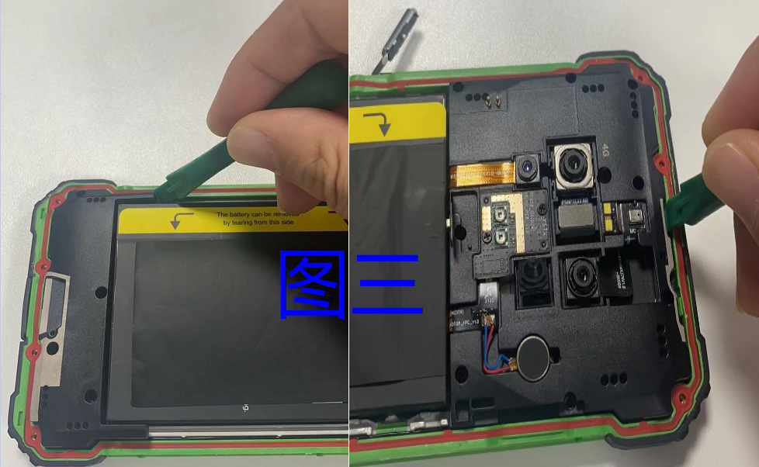
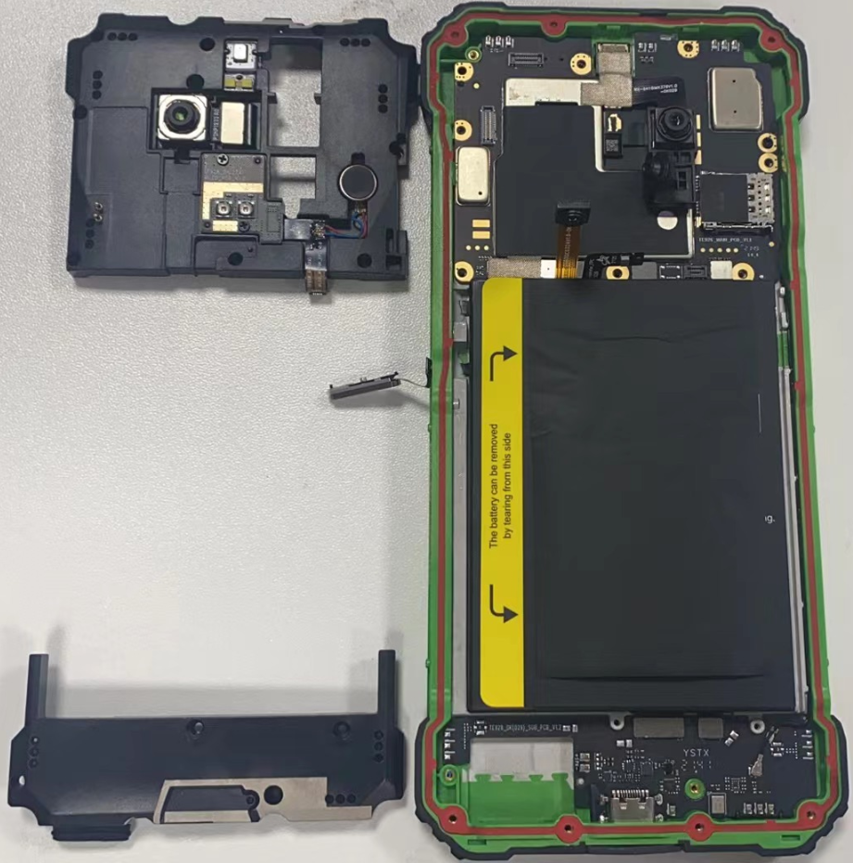
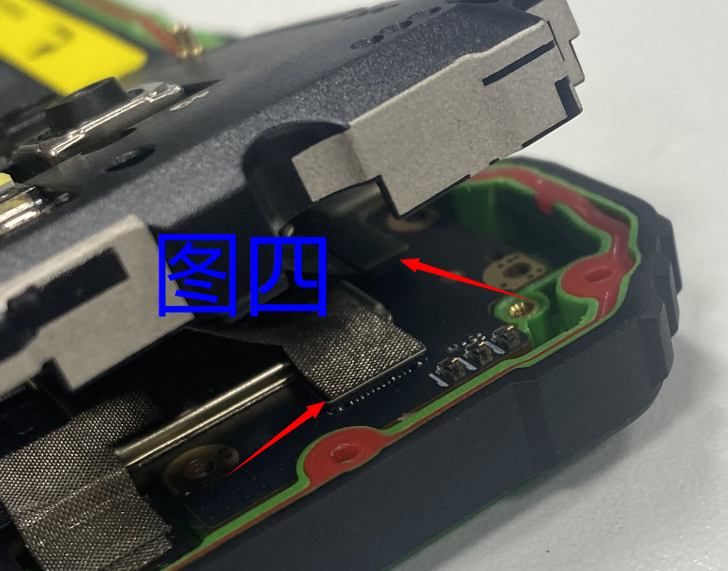
4.3、拆主板支架和喇叭
Remove motherboard stand and speaker
4.3.1、用撬棒撬主板支架顶部和喇叭，如图三
Use the crowbar to pry up top of motherboard stand and speaker, as below picture 3
4.3.2、拆顶部时注意，要等撬开后，用镊子取下闪光灯FPC和后主摄像头FPC，如图四箭头所示，
When removing the top of motherboard stand , note that need to use tweezers to remove the flash FPC and the rear main camera FPC after prying open, as below picture 4
3
4

Slide 11
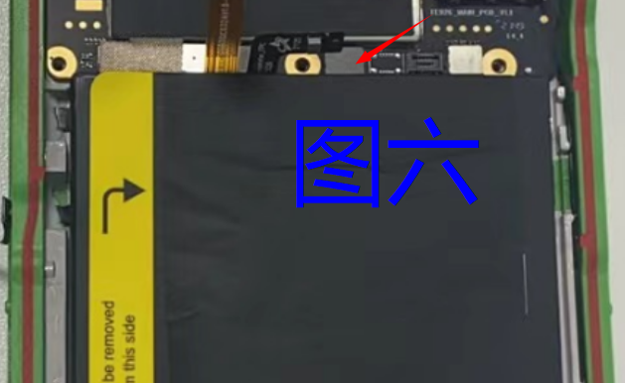
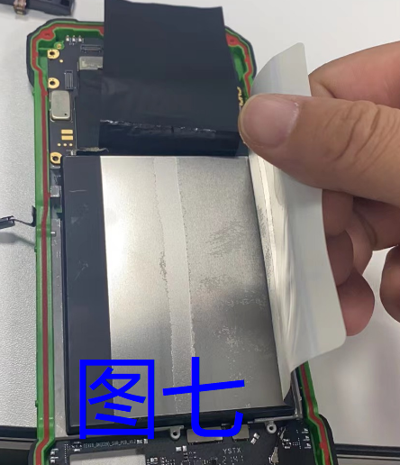
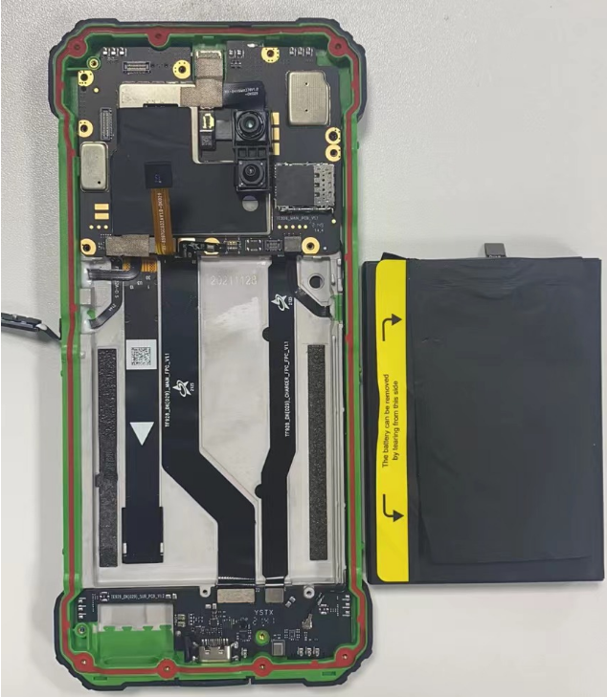
4.4、拆卸电池
Remove the battery
先拆开电池FPC，按电池贴纸上箭头方向撕下贴纸，然后慢慢拉扯，取下电池。
Firstly open the battery FPC, tear off the sticker according to the direction of the arrow on the battery sticker as below picture 5, and then pull it slowly to remove the battery as belowl picture 6
5
6

Slide 12
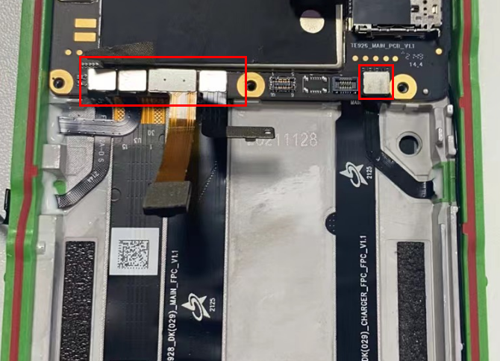
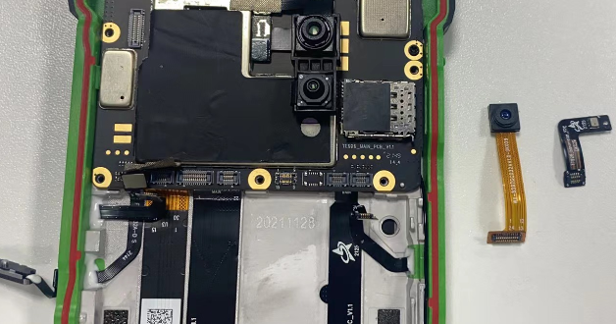
4.5、拆指纹、侧键、后副摄像头、气压、快捷键FPC
Remove fingerprint, side key, rear secondary camera, air pressure, shortcut key FPC
撕开导电布，然后依次拆下指纹、侧键、后副摄像头、气压、快捷键FPC
Tear off the conductive fabric, and then remove the fingerprint, side key, rear secondary camera, air pressure, shortcut key FPC in sequence

Slide 13
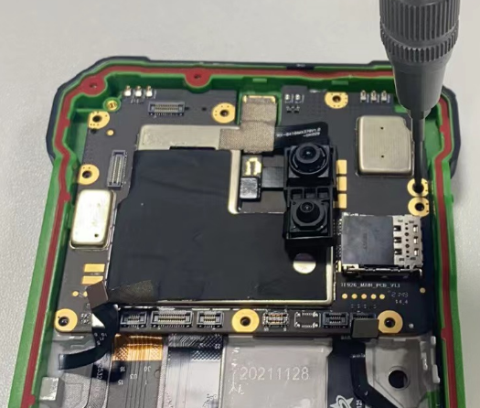
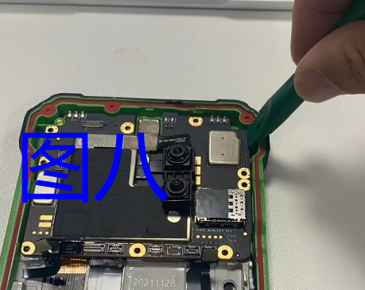
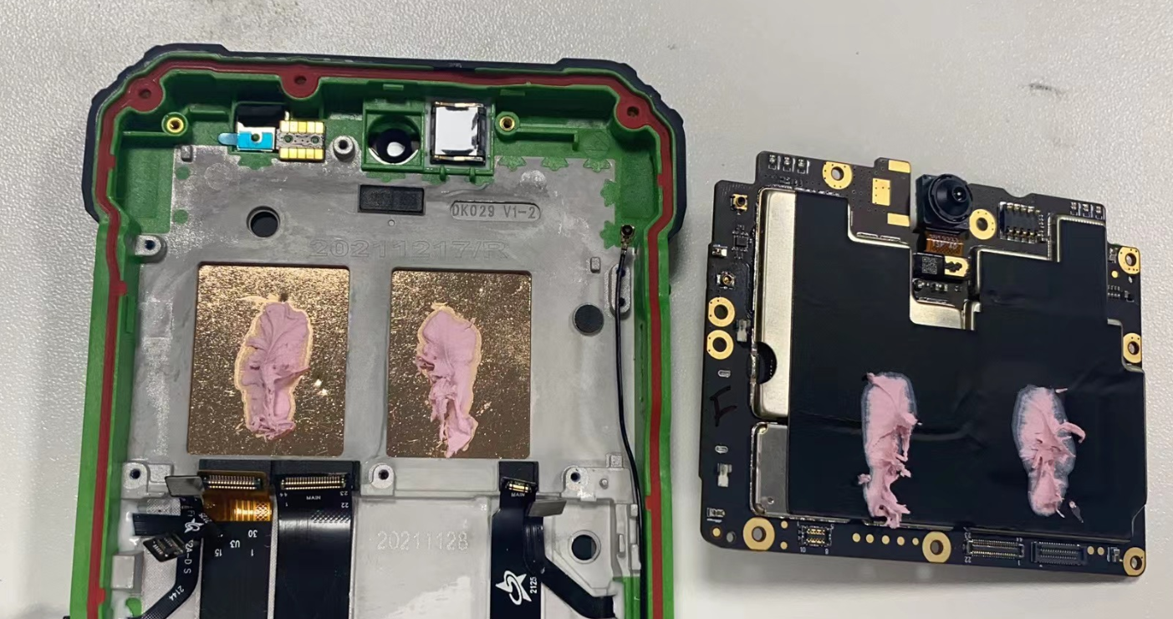
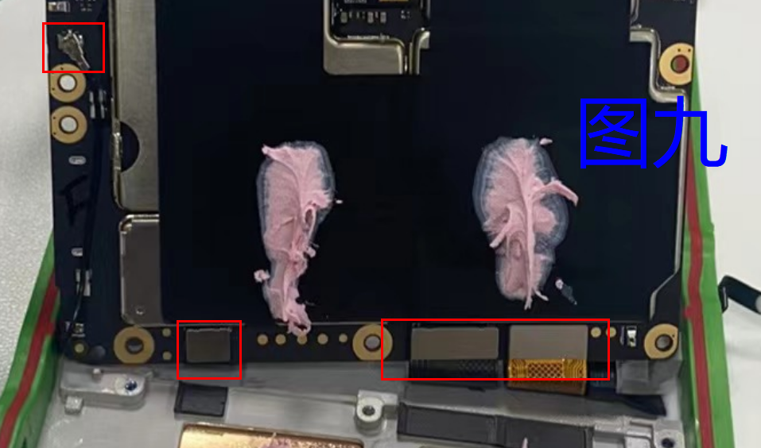
4.6、拆卸主板
Remove motherboard
取下主板固定螺丝，然后撬棒轻轻撬动主板右上角，如图七。然后轻轻抬起主板，拆下屏FPC、主FPC、充电FPC、同轴线。
Remove the screws fixing the motherboard, use the crowbar to pry up top right corner on motherboard, as below picture 8, then gently lift the motherboard, remove the screen FPC, the main FPC, the charging FPC, and the coaxial line.
7

Slide 14
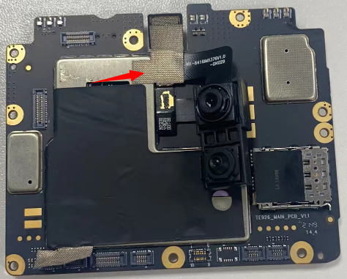
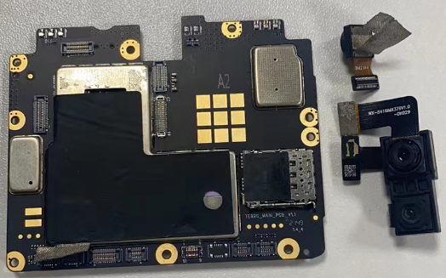
4.7、拆前摄像头、广角、夜视摄像头
Remove front camera、wide angle、night vision camera
先撕下前摄导电布，然后扣下前摄像头、广角、夜视摄像头
Tear off the front camera conductive fabric, then buckle front camera、wide angle、night vision camera

Slide 15
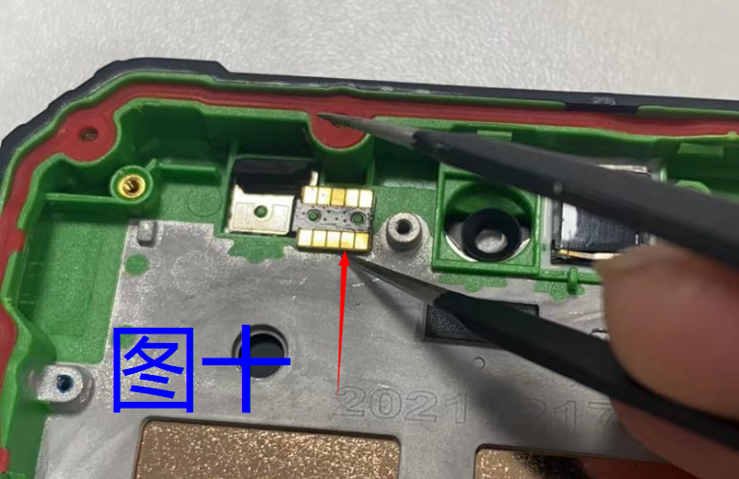
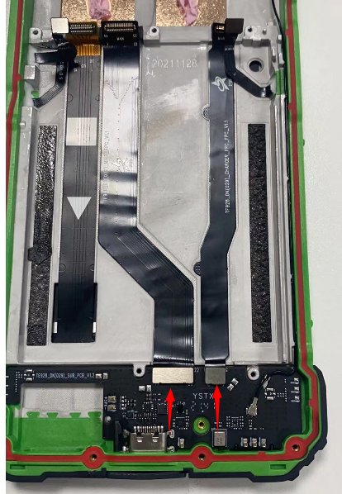
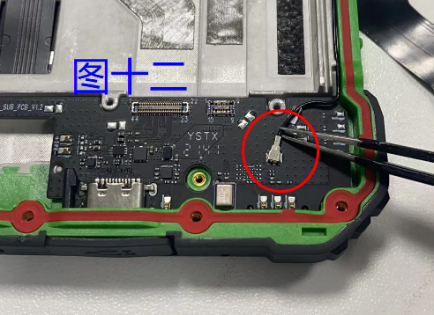
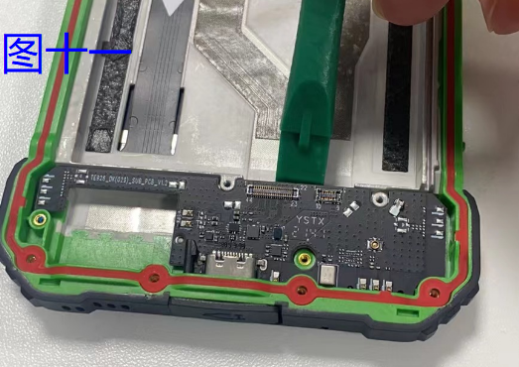
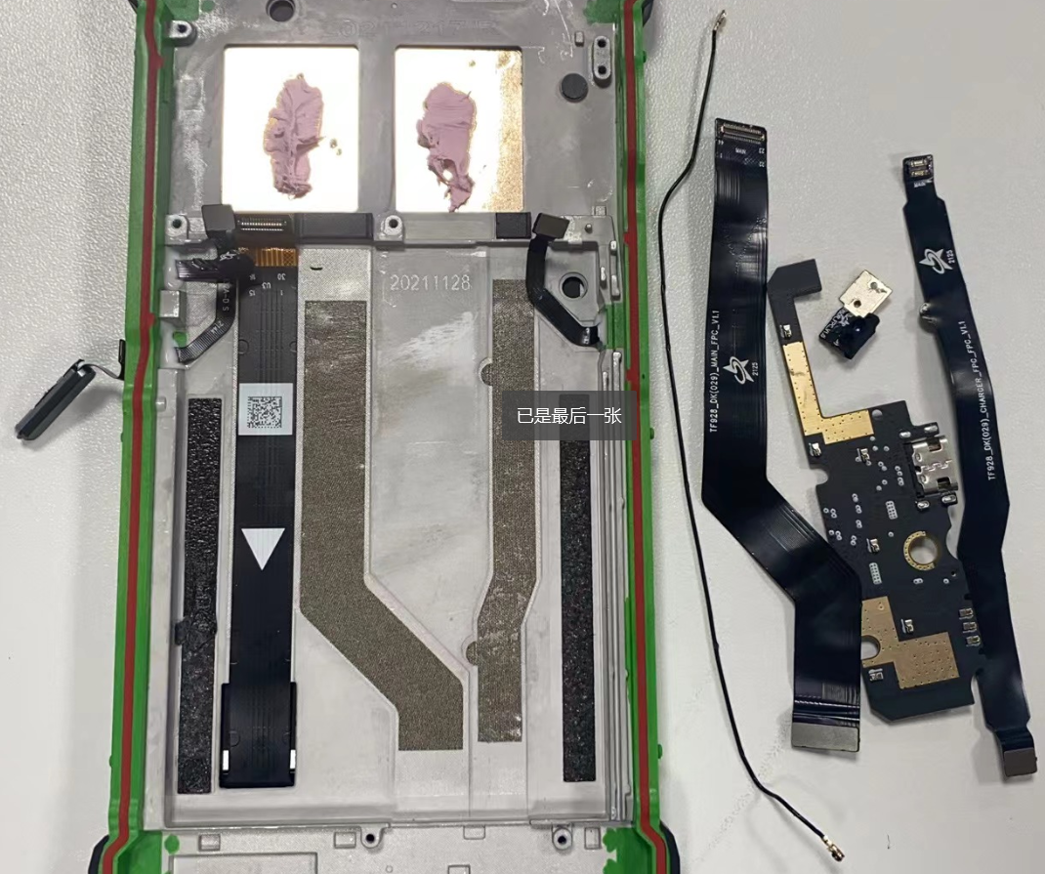
4.8、光感、主FPC、充电FPC、USB小板
Light sensor、main FPC、charging FPC、USB charging board
4.8.1、用镊子轻轻撬起光感FPC，如图八
Use the tweezers to pry up the light sensor, as picture 10
4.8.2、扣下主FPC和充电FPC，并撕下
Buckle the main FPC and charging FPC, and tear it off
4.8.3、拆小板同轴线，并取下，如图九
Remove the coaxial line of the charger board and remove it
as picture 12
4.8.4、使用撬棒，轻轻撬下USB小板，并取下，如图十
Use the crowbar to pry up USB charging board, and take it out, as picture 11
10
8
9

Slide 16
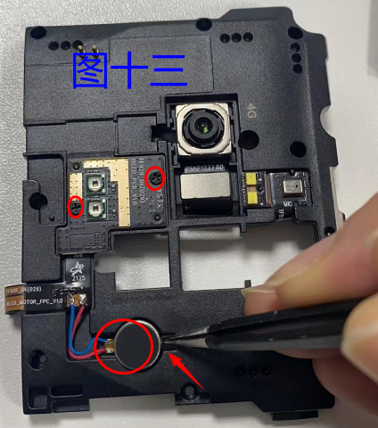
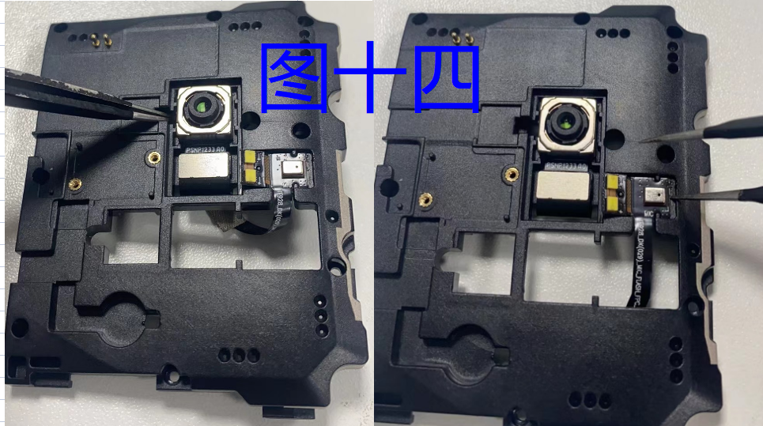
4.9、拆主板支架
Remove motherboard stand
4.9.1、拆红外小板螺丝、马达：先取下红外小板螺丝，然后用镊子撬下马达，使用烙铁焊下马达线
Remove infrared small board screws and motors: first remove the infrared small board screws, then pry off the motor with tweezers, and use the soldering iron to solder the motor wire as below picture 11
4.9.2、拆后主摄像头和副麦FPC，使用镊子轻轻撬起后摄像头和副麦FPC，如图十二
Remove the rear main camera and the second micphone FPC, and use tweezers to gently pry up the rear camera and second micphone FPC, as picture 12
11
12

Slide 17
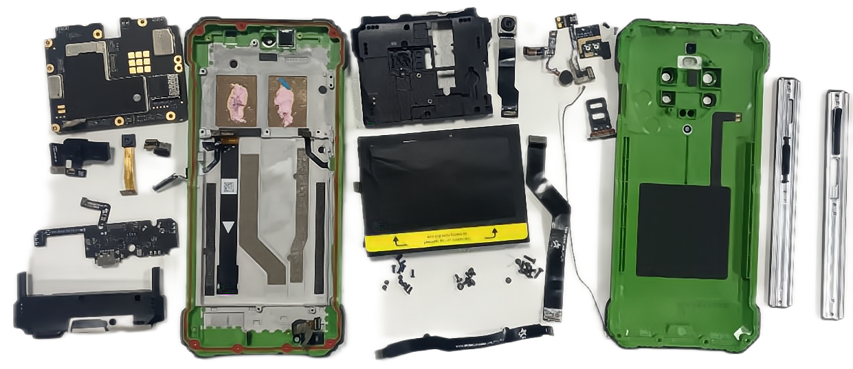
4.10、手机整体展示
Overall display of mobile phone

Slide 18
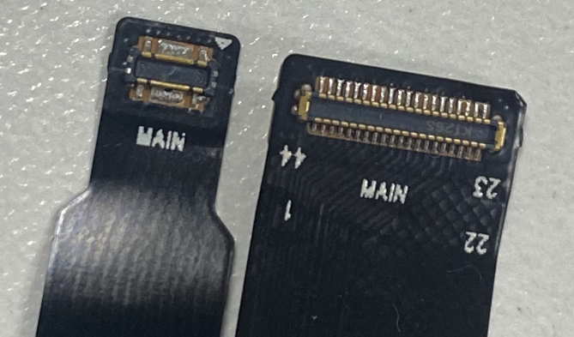
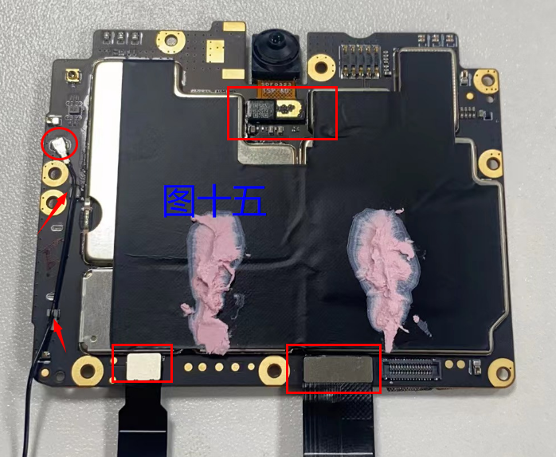
5、装机步骤 5、Installation steps
5.1、扣前摄像头、同轴线、主FPC、充电FPC，注意：FPC一端有MAIN字样的扣在主板端，同轴线扣好后将引线卡紧在槽位内。如图十三
Buckle the front camera, coaxial line, main FPC, and charging FPC. Note: FPC with words ‘MAIN’should buckled in the end of the motherboard, fasten the lead in the slot after buckle the coaxial line. As picture 13
13

Slide 19
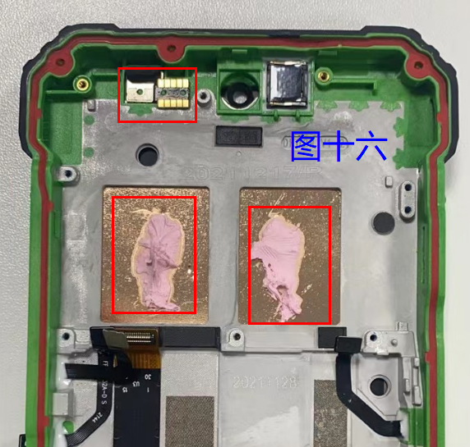
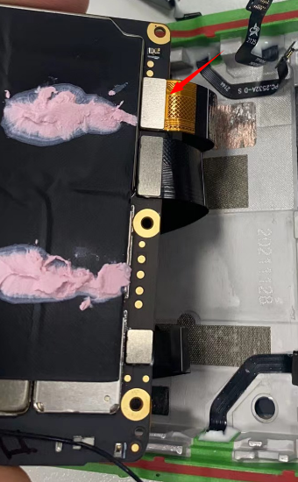
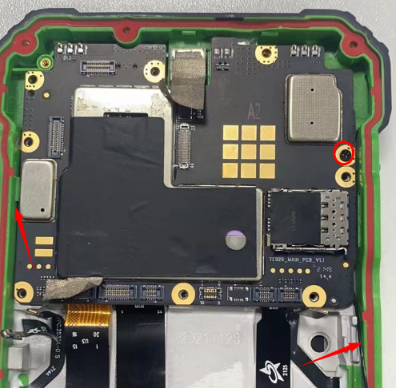
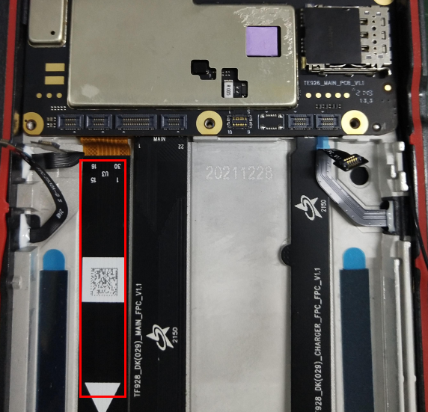
5.2、装光感FPC、主板
Install light sensor FPC、motherboard
5.2.1、将光感胶套套到光感器上, 把光感FPC折弯对准定位柱放入面壳槽位中轻力按压平粘紧。如图十四
Put the light sensor glue sleeve into the light sensor, put the light-sensing FPC bending alignment positioning column into the groove of the surface shell, and press flat and stick tightly gently.
5.2.2、在散热铜管上打散热膏
Put thermal grease on the heat dissipating copper pipe
5.2.3、先将屏FPC对准主板连接器轻力按压扣紧，将主板左边倾斜对准屏组件扣位固定，将1pcs螺丝把主板锁紧在面壳上，将屏FPC理直粘上。
First, align the screen FPC with motherboard connector by light pressure and fastening, the motherboard should be tilted on the left side align to the screen module locked and fixed it, use 1pcs screw to lock the motherboard on the screen module, and stick screen FPC.
14

Slide 20
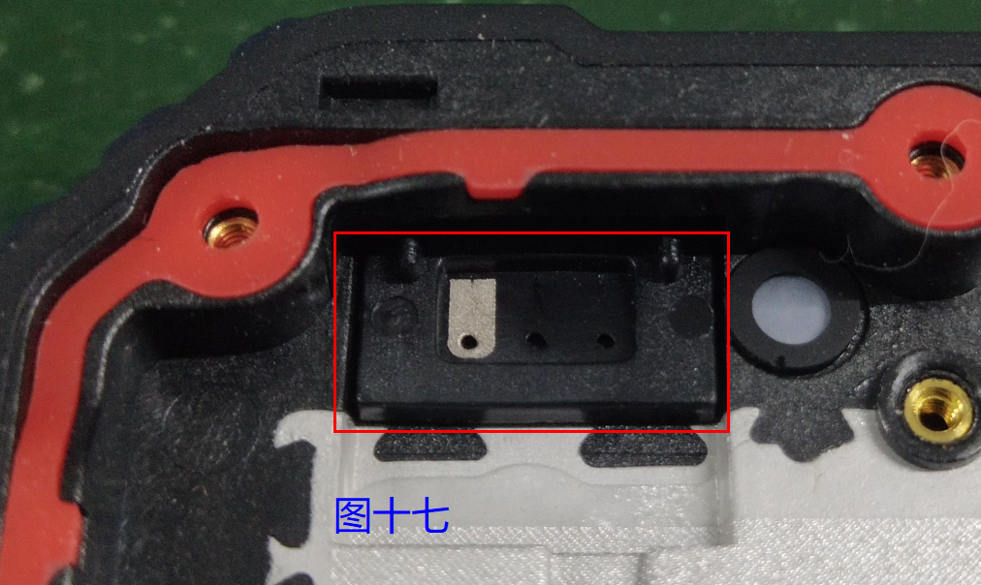
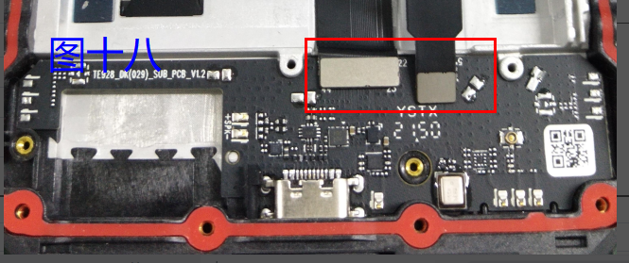
5.3、装USB小板、扣排线
Install USB charging board、buckle flat cable
5.3.1、先将底壳位置装上4G天线，如图十五
Firstly, install the 4G antenna to the bottom shell position, as picture 17
5.3.2、将USB小板放入底壳位置，并扣上主FPC和充电FPC，如图十六
Install USB charging board to the bottom shell position, buckle main FPC and charging FPC, as picture 18
16
15

Slide 21
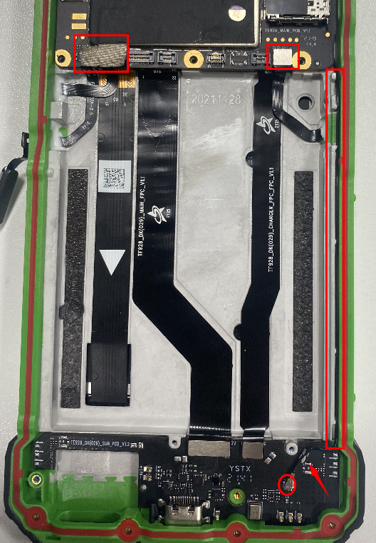
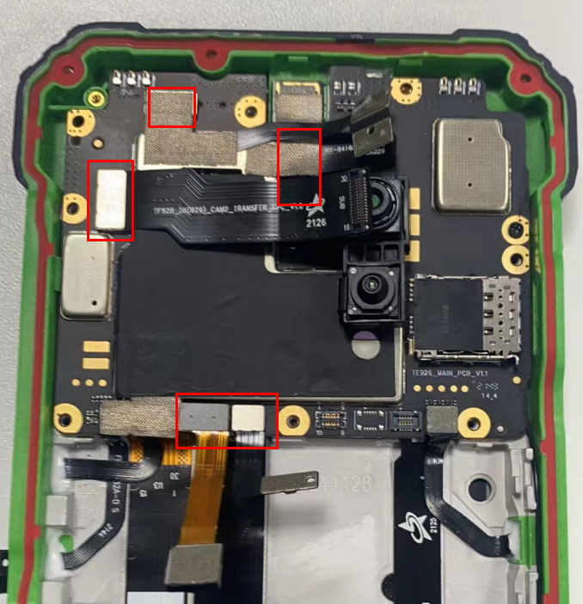
5.4、理直FPC、埋好同轴线、扣好三个按键FPC
Straighten the FPC, bury the coaxial line, and buckle the three buttons FPC
5.5、扣后副摄像头、夜视广角摄像头、主摄像头延长FPC、副麦FPC、气压FPC
Buckle rear secondary camera、night vision wide-angle camera, main camera extension FPC, secondrary micphone FPC, air pressure FPC

Slide 22
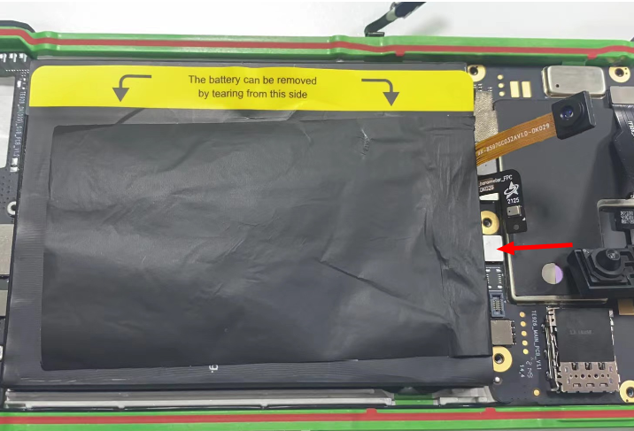
5.6、装入电池并扣好电池FPC。
Install the battery and locked the battery FPC.

Slide 23


5.7、装喇叭
Install the speaker
将喇叭防水圈区分好方向套在喇叭孔上，喇叭倾斜装入底壳喇叭槽位内按压固定，并锁上四颗螺丝。
Put the speaker waterproof ring distinguish correct direction on the speaker hole, install aslant speaker to the speaker bottom shell slot, pressing and fixing it, and locked four screws.

Slide 24


5.8、扣红外FPC，装主板支架
Buckle infrared FPC, install motherboard bracket
将主板上扣好的摄像头、FPC穿过支架孔，并锁上螺丝
Put the camera and FPC fastened on the motherboard through the bracket hole and lock the screws

Slide 25


5.9、固定副麦FPC、气压FPC、扣主摄像头并固定、固定副摄像头，检查防水圈
Fixing the secondary micphone FPC, air pressure FPC, buckle the main camera and fixing it, and fixing the secondary camera, check the waterproof ring

Slide 26

5.10、装底壳，打螺丝
Install the buttom shell and screw
注意：顶部第三个螺丝是短螺丝，
Note: The third screw at the top is the short screw

Slide 27


5.11、装侧面装饰件和按键，打螺丝
Install side trim and buttons and screws
注意：侧面音量键注意方向
Note: Side volume key note orientation

Slide 28
6、软件升级操作
Software updating operations

Slide 29

7、分模块常见问题维修方法
Maintenance method of common problems by module
7.1不开机问题
Problem of the phone not turn on
A、首先长按开机键5秒看机器能否开，如能开，则是判断问题(误判）；如果不能开机，则需进行下一步分析。
A、First, long press the power button for 5 seconds to check if the phone can be turn on, if can turn on, it is the judge the problem (erroneous judgement); If the device cannot be turn on, need to analysis next step.
B、先将USB电流计和充电器串联，对机器进行充电，充十分钟左右时间，看电流计上电流显示，能否达到1A以上。
B、First USB ammeter and charger in series, charging the phone, charge about ten minutes, check the current display on the ammeter if can reach more than 1A.
C、若电流能达到1A以上，说明机器充电正常，接着继续充电后看能不能开机，若能开机，则说明机器是因为电池低电导致不开机；若还不能开机，可能是主板不良，按拆机步骤进行拆机更换主板。
C、If the current can reach more than 1A, it means that the phone can be charged normally, and then continue to charging to check whether it can be turned on. If it can be turned on, it means that the problem is low battery power; If the phone can’t be turn on, maybe the motherboard problem, according to the disassembly steps to replace the motherboard.
D、若电流不能达到1A以上，说明机器充电也是有问题，需对主板、USB小板、电池继续交换验证，确认哪个物料问题进行更换。
D、If the current cannot reach more than 1A, it indicates that there is a problem with the charging. It is necessary to continue to exchange and verify of the motherboard, USB charging board and battery to confirm which spare parts is faulty and need to replaced.

Slide 30
7.2、不充电问题
Not charging problem
参照7.1不开机中B-D部分。
Refer to 7.1 B-D not turn on part.
7.3、相机问题
Camera problem
主要要分清前后拍照问题，绝大多数为摄像头物料问题，按拆装机步骤进行更换对应摄像头。
The main problem is to distinguish between the front camera and back camera, the vast majority of camera material problems, according to the dismantling and installation steps to replace the corresponding camera.
7.4、喇叭类问题
Speaker problem
主要有喇叭杂音、无声或其他类音频问题，主要也是喇叭物料问题，按拆装机步骤进行更换喇叭。
The speaker mainly problem is noise, silence or other audio problems, mainly also the material problems, according to the removal and installation steps to replace the speaker.

Slide 31
7.5、麦克问题
Micphone problem
麦克问题，主要为USB小板问题，麦克是在小板上的，可根据拆装机步骤更换小板。
The micphone problem is mainly the USB charging board problem, because the micphone is on the charger board. The charger board can be replaced according to the disassembling and installing steps.
或者检查麦克孔有无堵塞、麦克密封套是否装到位等。
Or check if the micphone hole is blocked, whether the mic sealing sleeve is installed in place, etc.
7.6、指纹问题 7.6、 Fingerprint problem
如果指纹解锁不了，进入指纹录入界面，设置-安全-解锁方式，进入指纹解锁中去重新录入指纹。还是不能使用的话，更换指纹物料
If the fingerprint cannot be unlocked, enter the fingerprint input interface, settings - security - unlock mode, enter the fingerprint unlock to re-set it. If still can not be used, replace the fingerprint sensor material
或者在解锁界面如果没有指纹解锁按钮，那说明指纹物料出现了问题，需要重新更换。
If there is no fingerprint unlock button on the unlock interface, it means that there is a problem with the fingerprint material and it needs to be replaced.

Slide 32

8、产品爆炸图
The explosion pictures

Slide 33
BL8800Pro explosive view
NO. | 名称 | name of material | material code | NO. | 名称 | name of material | material code
1 | 听筒网 | Receiver net | DK014.340110011 | 22 | 贴合屏 | TP-LCD component(sub material) | DK029.140200011
2 | 指纹模组 | Fingerprint button(sub material) | DK029.330400011 | 23 | 散热铜管 | Cooling copper pipe | DK029.350130041
3 | 防水圈 | waterproof ring | DK029.310210031 | 24 | 左侧条 | left side | DK029.120130011
4 | 4G天线同轴线 | 4G antenna coaxial line | DK029.18100011 | 25 | 音量按键组件 | volume +/- keyboard | DK029.120110011
5 | 右侧条 | right side | DK029.120140011 | 26 | 广角摄像头 | Wide-angle camera | DK029.160200011
6 | 卡托 | card tray | DK029.121300011 | 27 | 天线四支架-4G | Antenna holder-4G | DK029.150100011
7 | 前摄密封胶套 | Front camera seal cover | DK029.310210081 | 28 | 补光灯小板 | Fill light board | DK029.110100091
8 | 前置摄像头 | Front camera | DK023.160300022 | 29 | 面壳组件 | Front case component | DK029.310100031
9 | 光距感密封胶套 | light distance+Signal indicator seal cover | DK029.310210091 | 30 | 快充FPC | Fast charging FPC | DK029.110100031
10 | 光距感模组 | light distance+Signal indicator FPC | DK029.110100061 | 31 | 主FPC | Main FPC | DK029.110100021
11 | 补光灯小板FPC | Fill light board FPC | DK029.110100081 | 32 | 电池 | Battery | DK029.211008611
12 | 主板组件 | PCBA | DK029.110000011 | 33 | 4G天线小板 | 4G antenna board | DK029.110100011
13 | 单假摄 | fake camera | DK029.160400012 | 34 | 气压FPC | Air pressure FPC | DK029.110100041
14 | 天线支架组件-4G | Diversity/BT/WIFI/GPS antenna component-4G | DK029.150110011 | 35 | 喇叭防水胶套 | speaker waterproof ring | DK029.310220011
15 | 后主摄像头转接排线 | rear main camera FPC | DK029.110100051 | 36 | NFC天线弹针 | NFC antenna pin | DK029.150120031
16 | 后主摄像头 | Rear camera | DK029.160100011 | 37 | BOX嘲叭-4G | Speaker 4G | DK029.170500011
17 | 闪光灯排线 | flashlight+mic FPC | DK029.110100071 | 38 | 马达 | motor | DK029.180100011
18 | 夜视摄像头 | Night vision camera | DK029.160300011 | 39 | 摄像头支架2 | camera holder 2 | DK029.310220031
19 | 底壳组件 | Back case component | DK029.310300031 | 40 | 副麦密封胶套 | sub mic seal cover | DK029.310220021
20 | 底壳螺丝1 | Back case screw | DK029.330800021 | 41 | 侧条螺丝 | side screw | DK029.330600011
21 | 单假摄像头镜片 | fake camer lens | DK029.360120011 | 42 | LOGO镜片 | logo lens | DK029.360130011

Slide 34
THANKS

